Slide 1
Goals this Week
1. Understand how to use if statements 2. Start working on the first PHP exercise

Slide 2
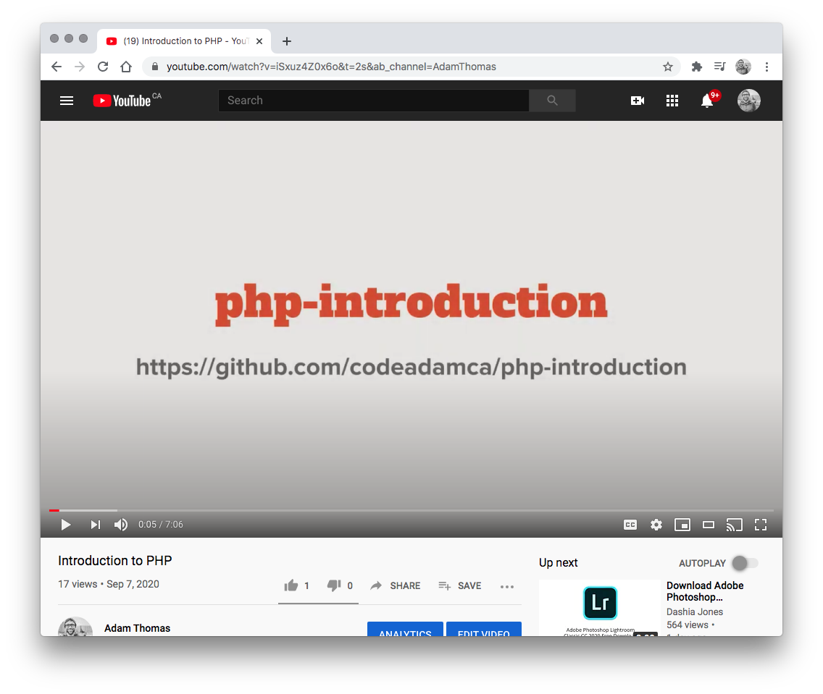

1. YouTube Videos
Watch the Following Youtube Videos:
PHP If Statements https://www.youtube.com/watch?v=81kE9pQHssQ

Slide 3
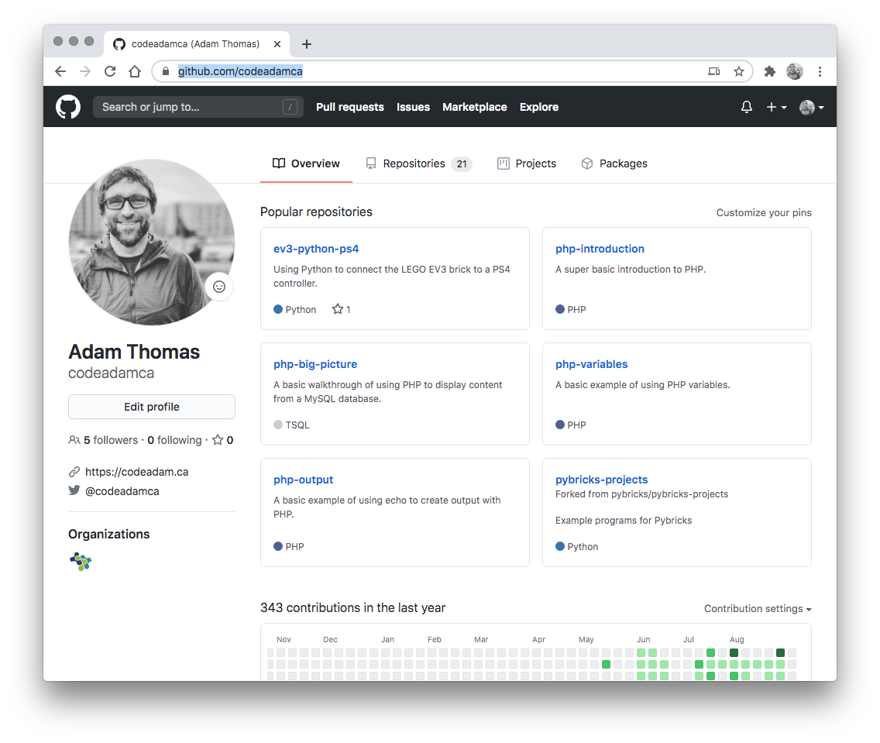

2. Review Code
Review the provided code and follow along with any coding instructions in GitHub:
PHP If and Switch https://github.com/codeadamca/php-if-switch

Slide 4
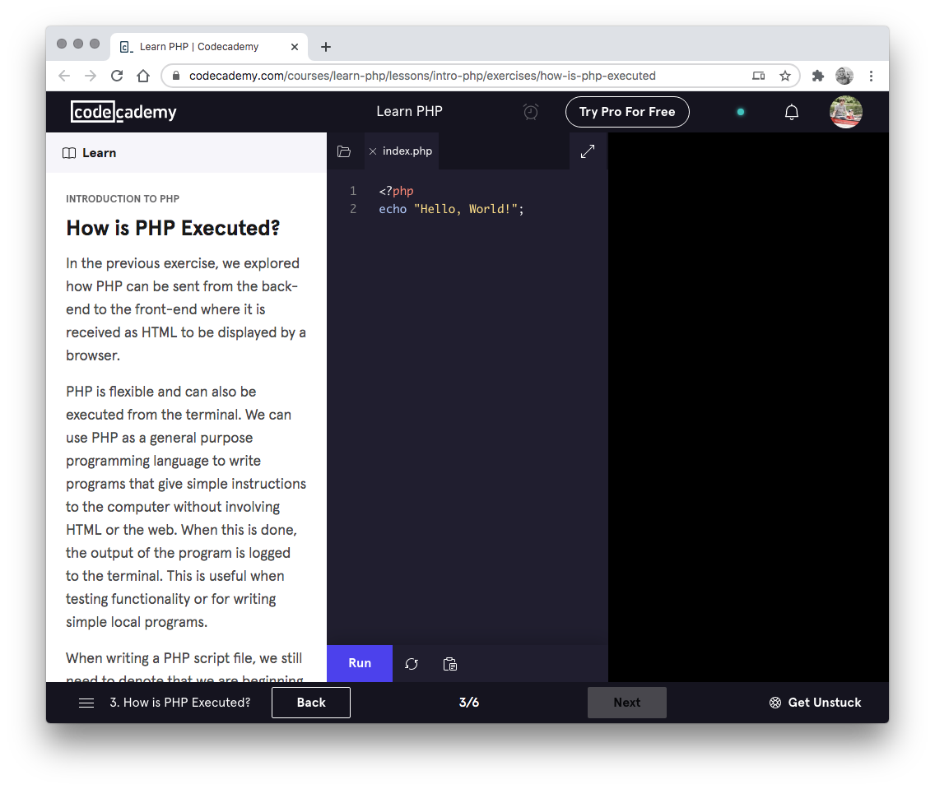

3. Codecademy
Complete the following Codecademy exercises:
PHP and Logic: https://www.codecademy.com/learn/learn-php-conditionals-and-logic

Slide 5
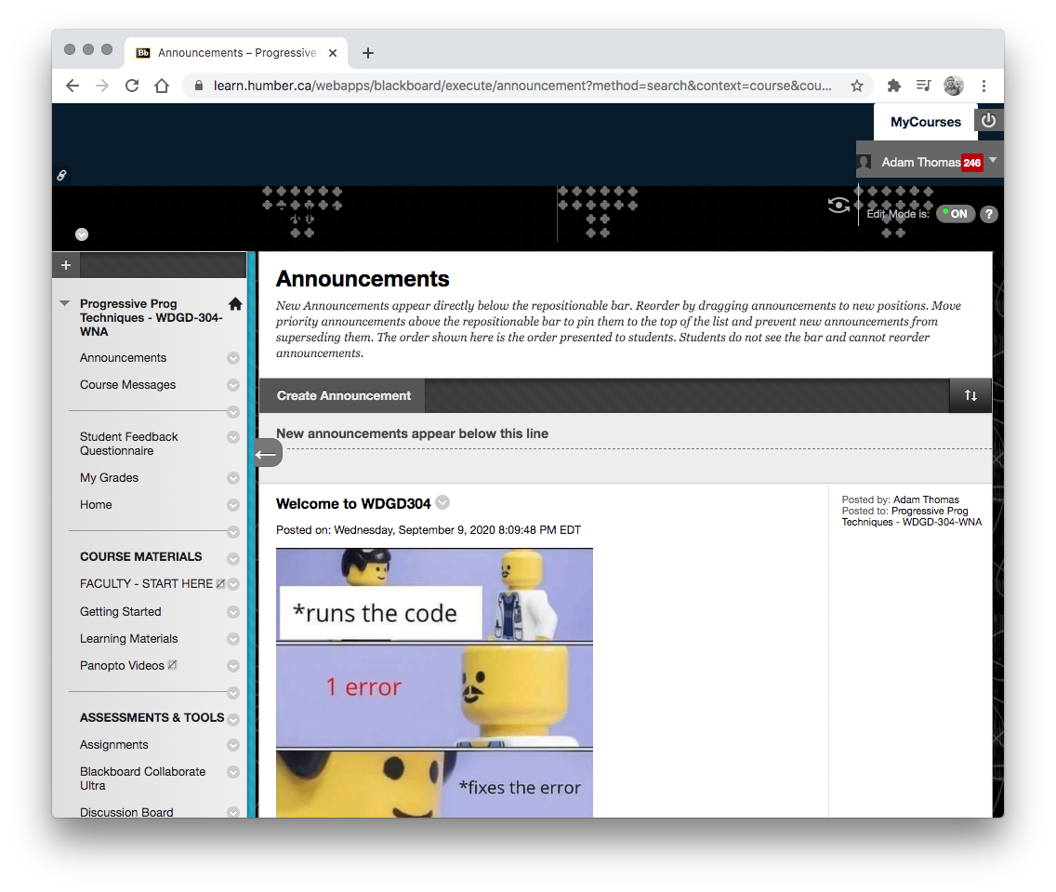
4. Exercises
Start your first PHP exercise.
Your first exercise will be done as individuals.
You will be required to create sample scripts using loops and if statements to achieve described tasks.

